Slide 1
UI for Web Site

Slide 2
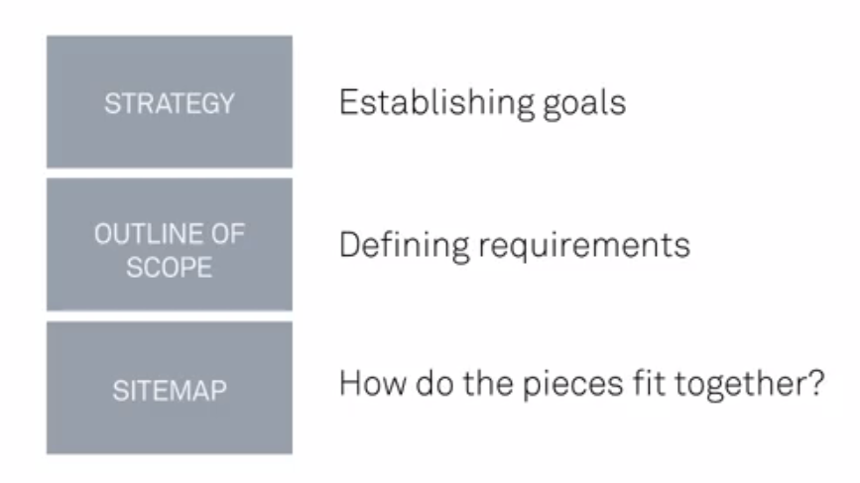

Slide 3
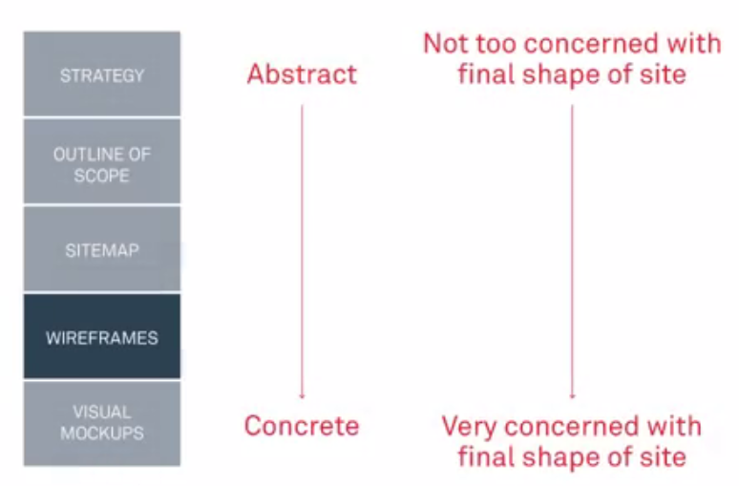

Slide 4
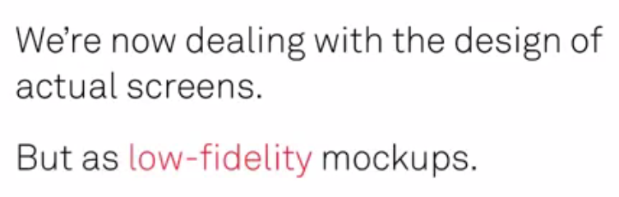

Slide 5
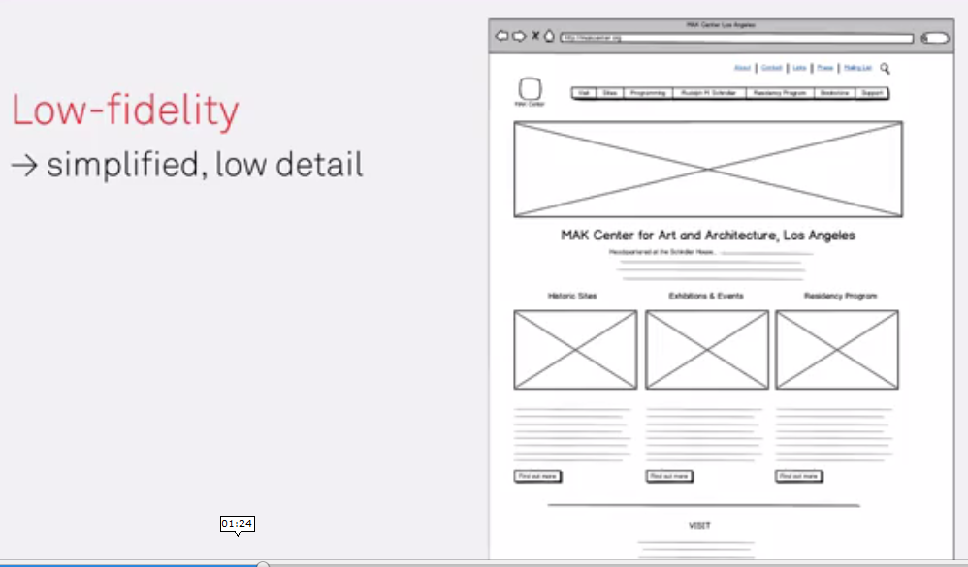

Slide 6
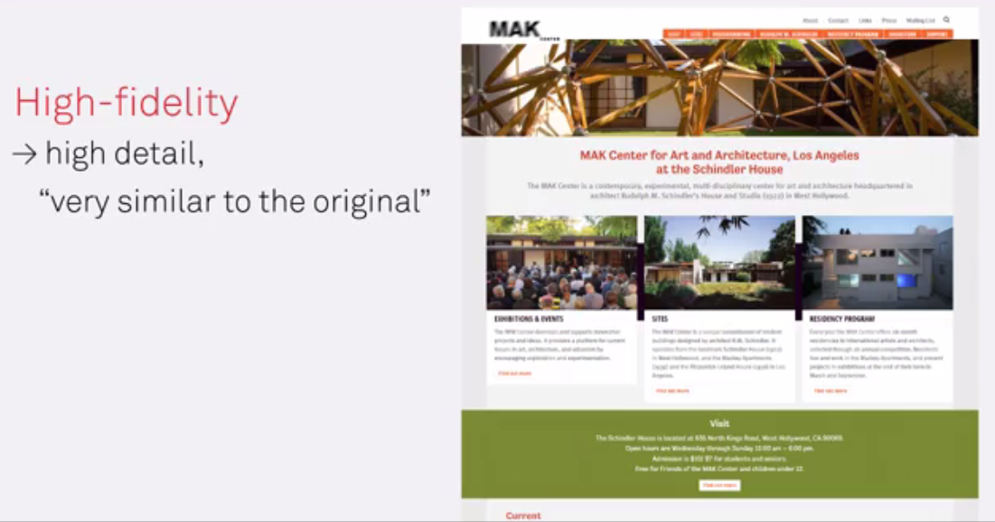

Slide 7
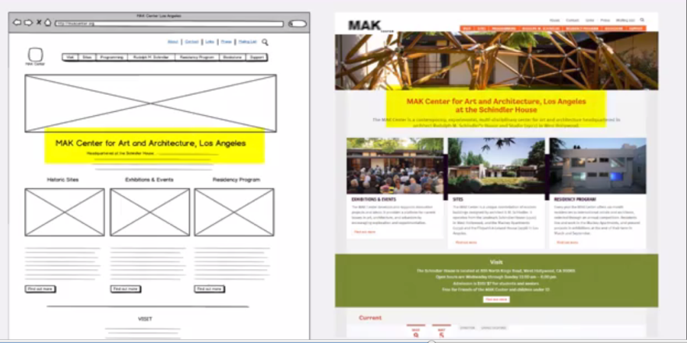
Emphasis on where to put what!
Structural decision - Like skeleton X-Ray
And High fidelity is skin

Slide 8
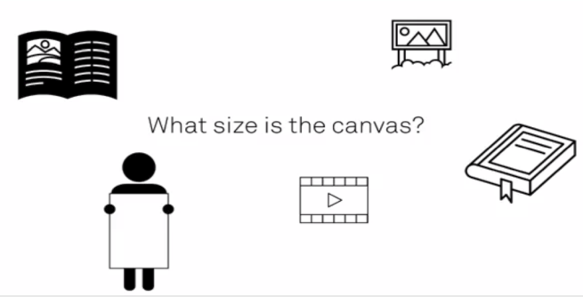
What size is the canvas

Slide 9
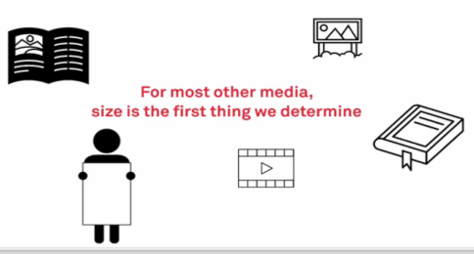
Pre-defined size

Slide 10
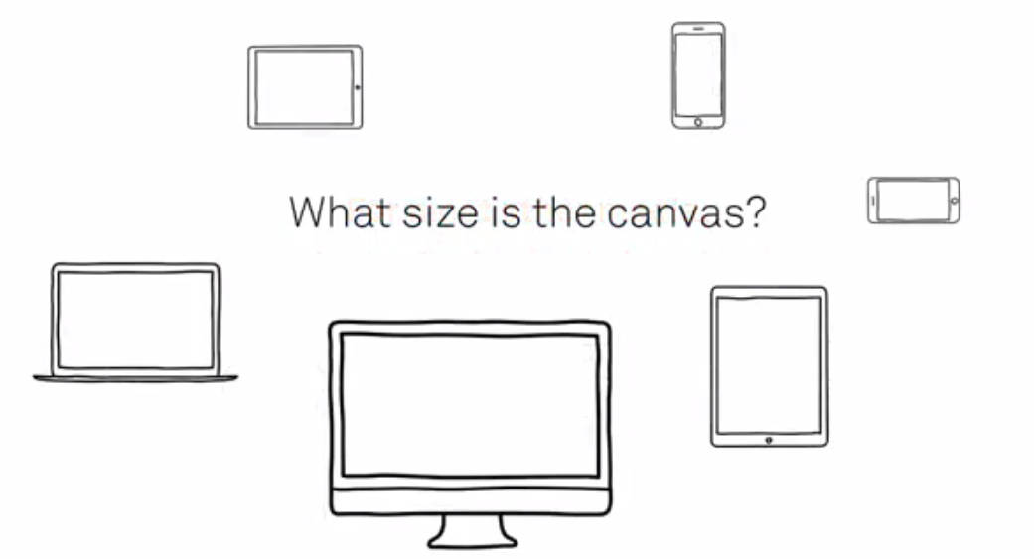
Websites do not have one specific size!

Slide 11
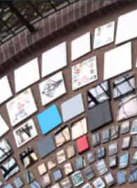
Responsive Design
Have to deal with lots of different sizes!

Slide 12
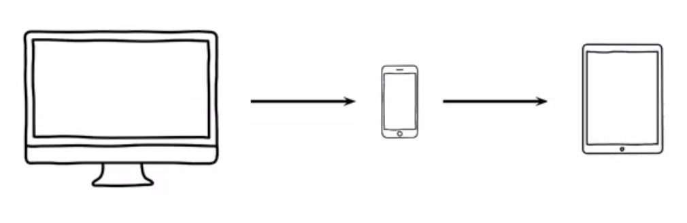
Reading an article in office …. On mobile on Train … finish it on tablet
Try reading a printed news paper on congested bus! Or use a mobile for it!

Slide 13
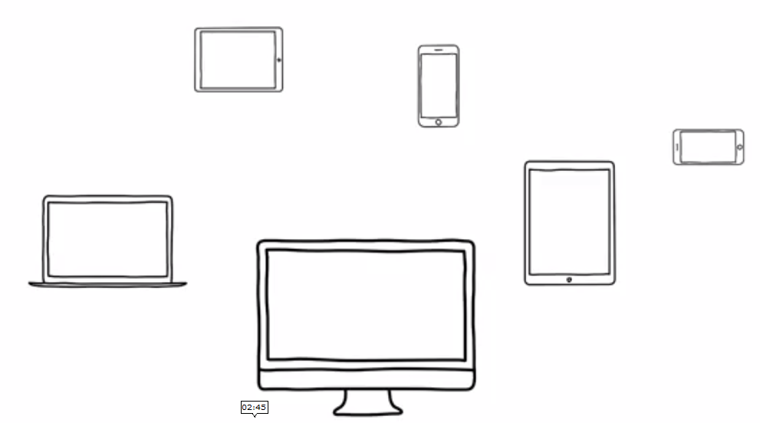
Designing website more complicated today

Slide 14
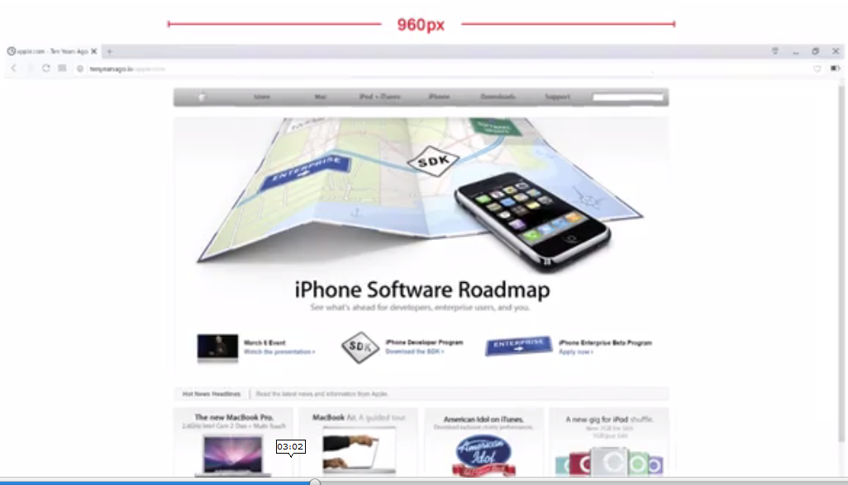
Long time standard!

Slide 15
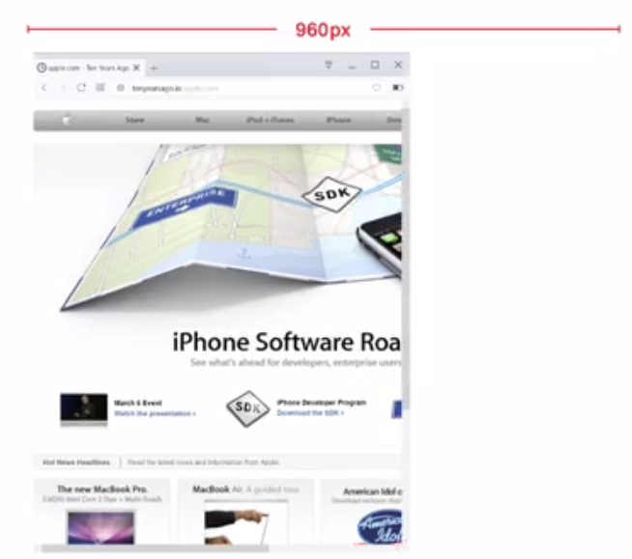
Window gets smaller ,,,
things get cut off!

Slide 16
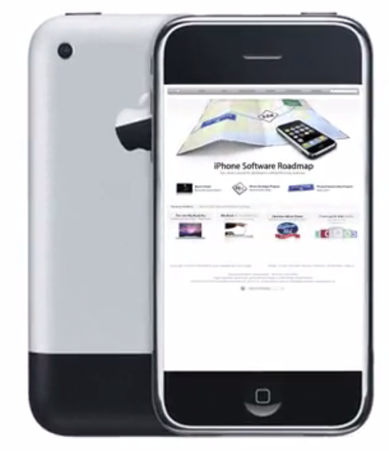
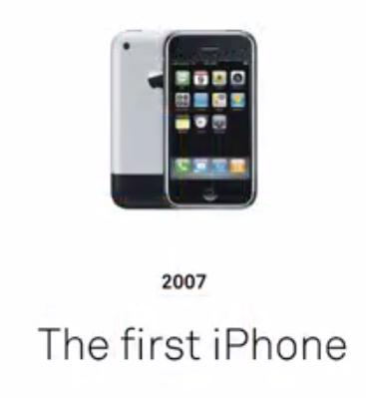

Slide 17
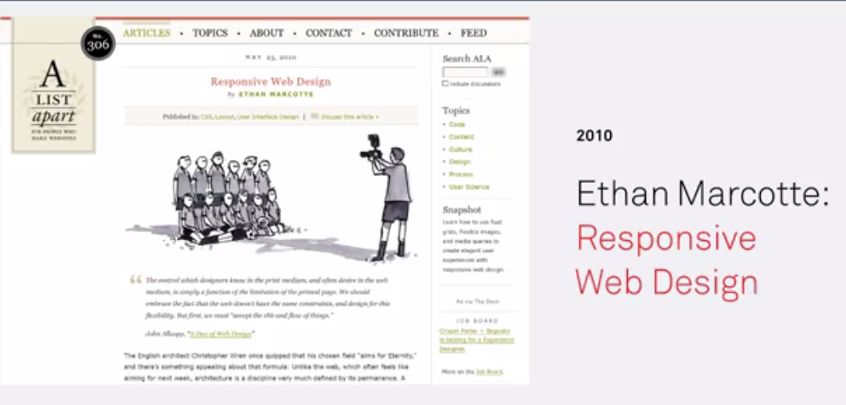

Slide 18
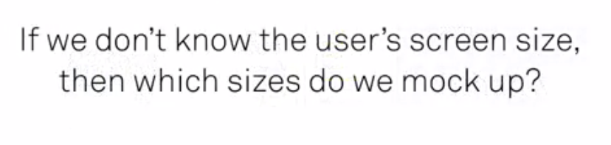

Slide 19
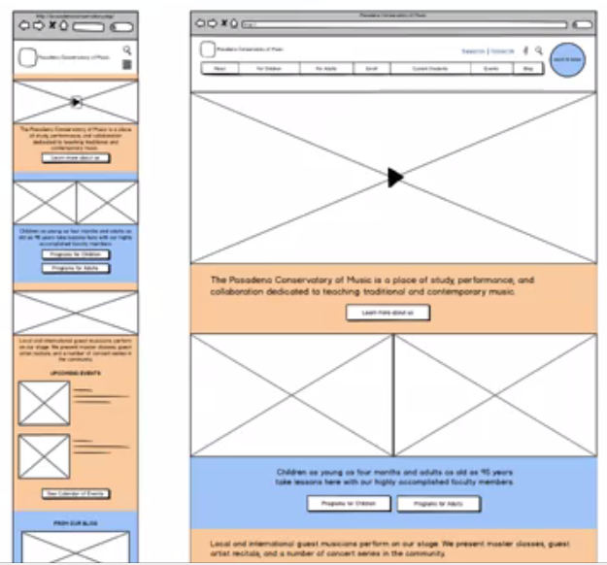

Slide 20
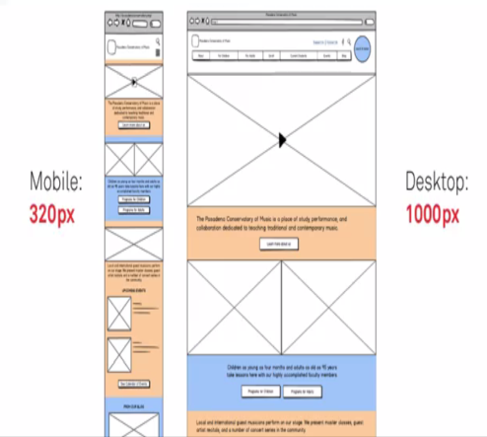
Horizontal Mobile
also important

Slide 21
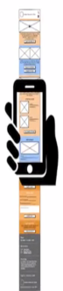
Scrolling

Slide 22
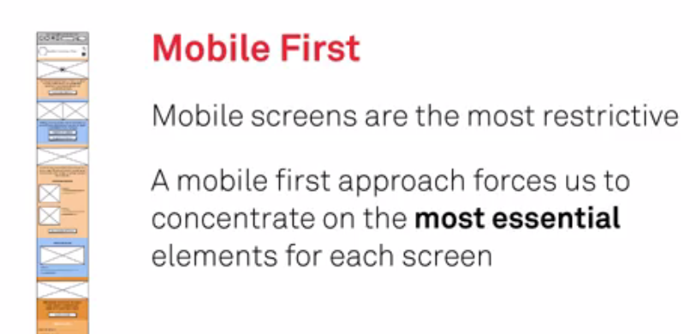
Which size to mockup first!

Slide 23


Slide 24
Navigation Systems
Already discussed in site map!

Slide 25
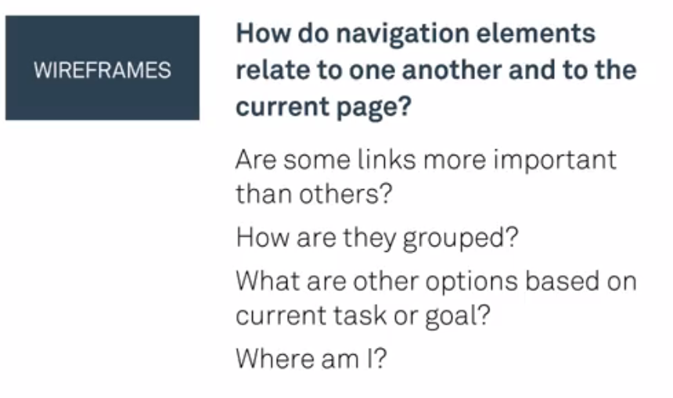

Slide 26
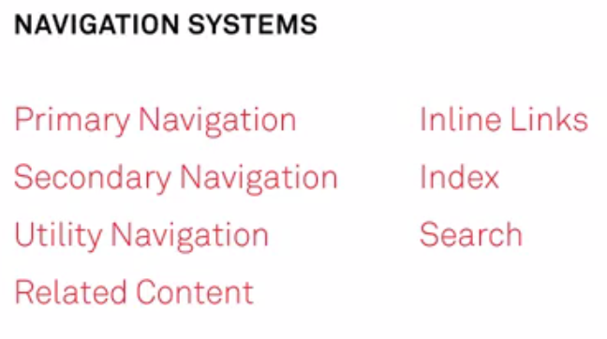

Slide 27
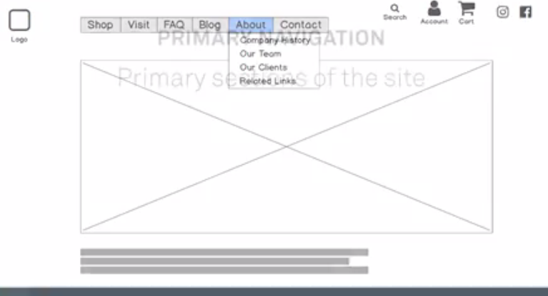

Slide 28
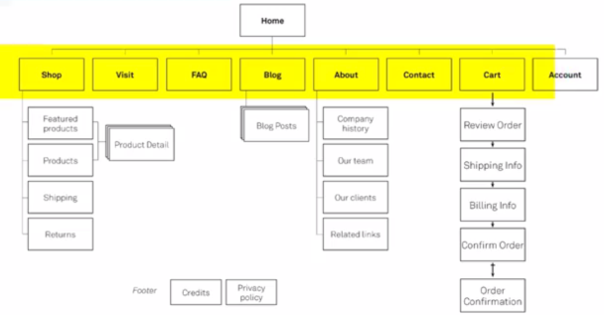

Slide 29
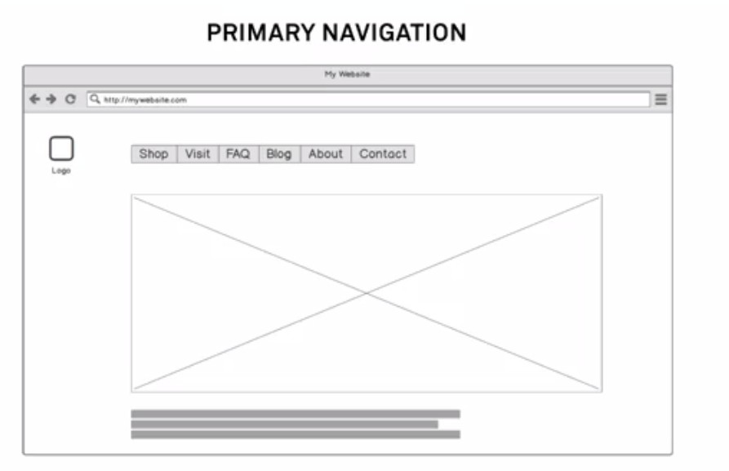

Slide 30
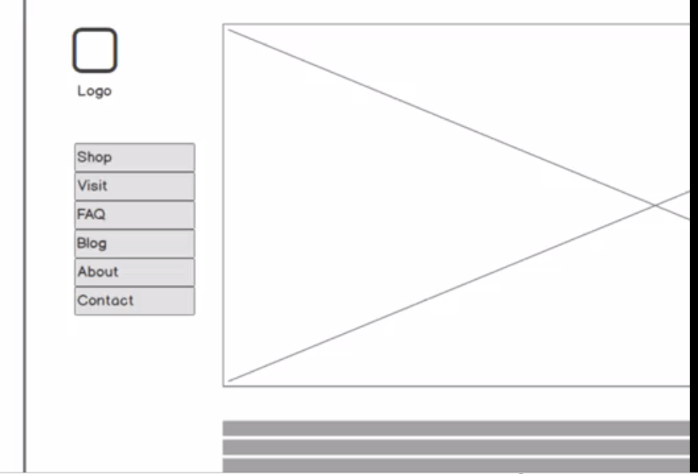

Slide 31
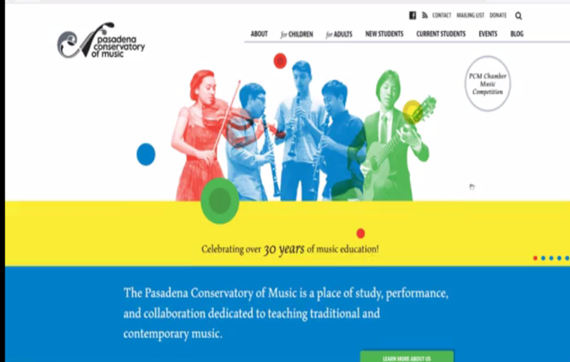

Slide 32
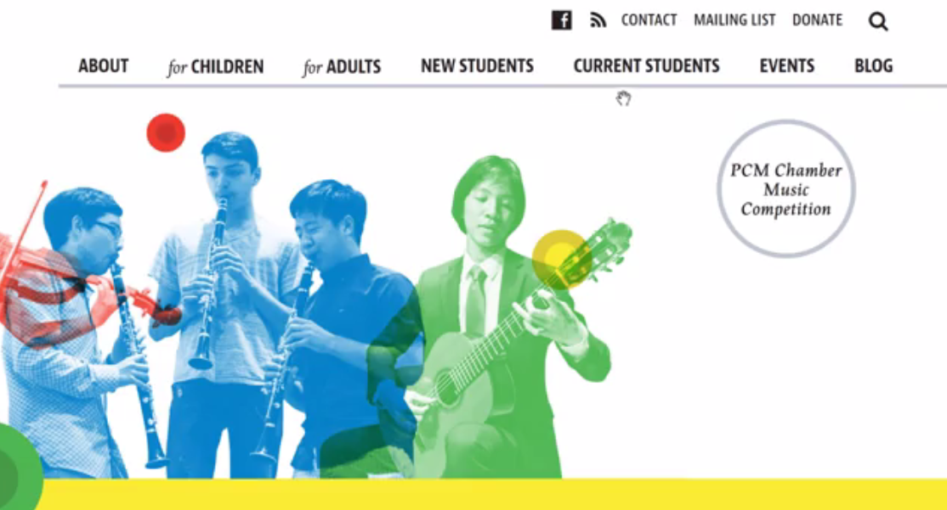

Slide 33
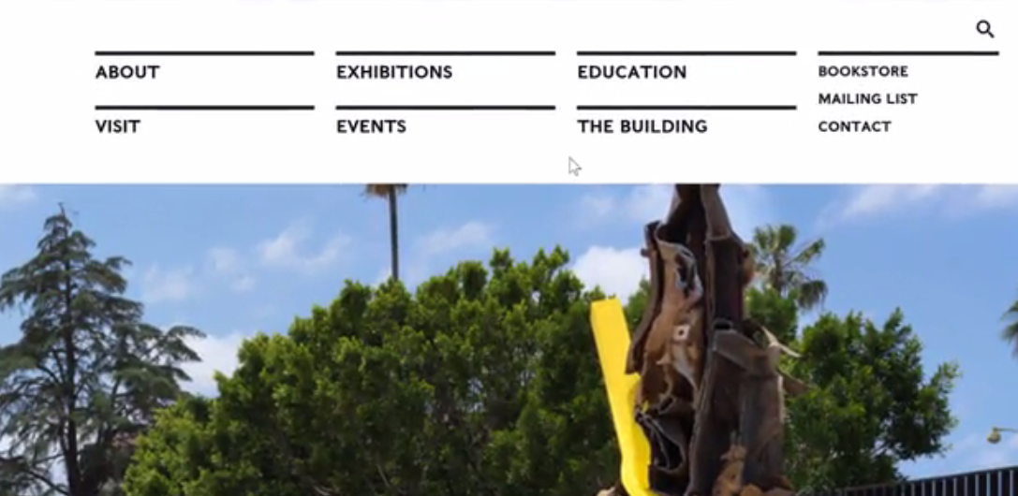

Slide 34
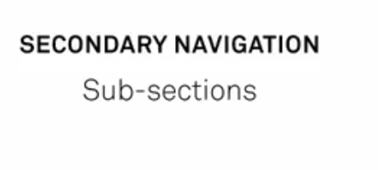
Some sites are so small that they get away with secondary navigation

Slide 35
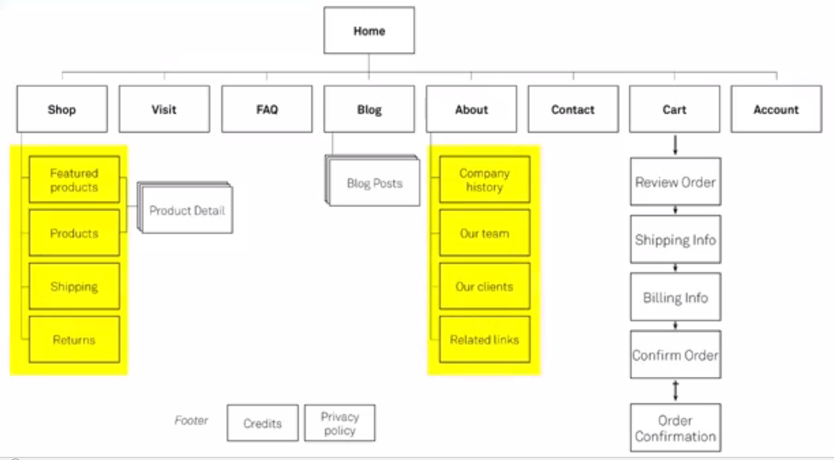

Slide 36
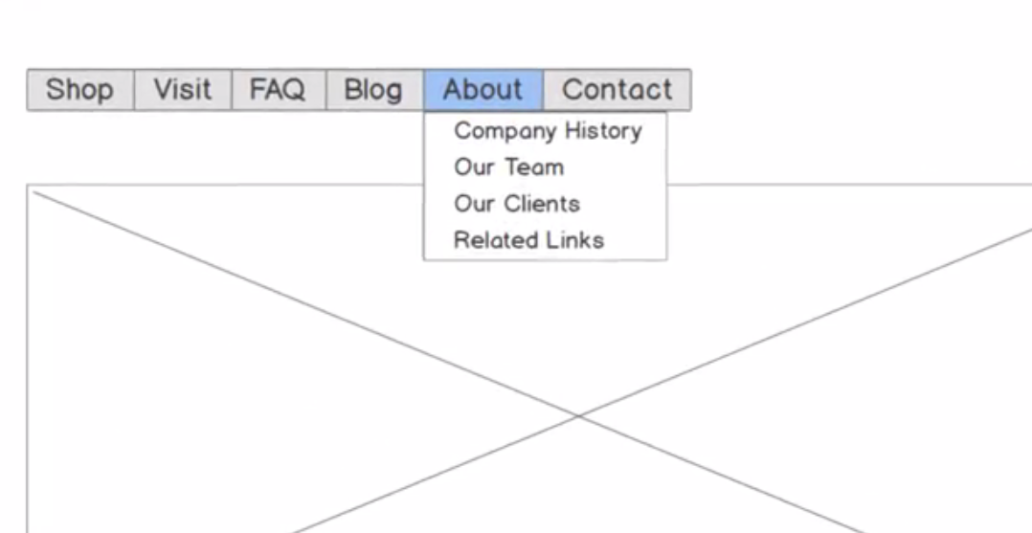
On Wireframe

Slide 37
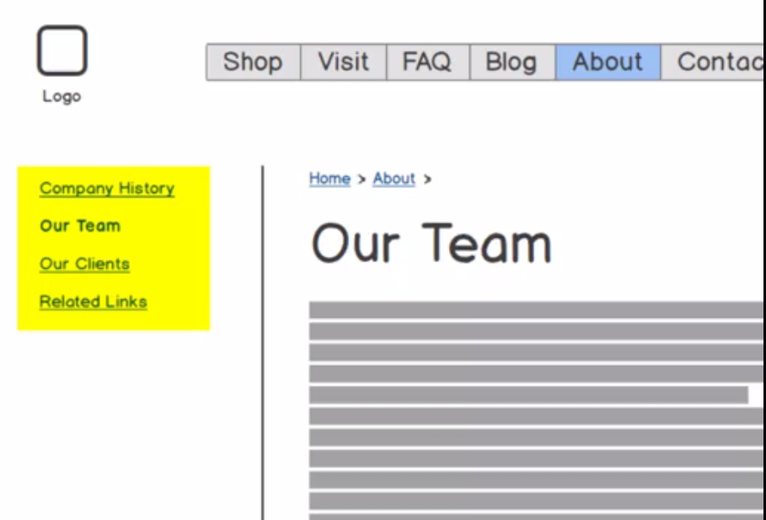

Slide 38
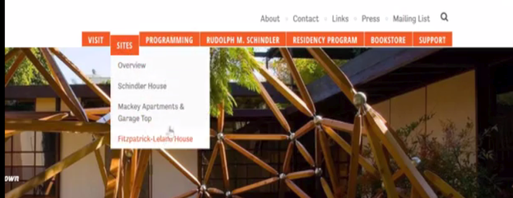

Slide 39
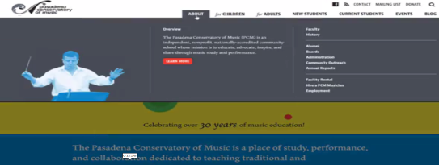
Fat menu – for desk top, not for mobile devices

Slide 40

Mobile device

Slide 41
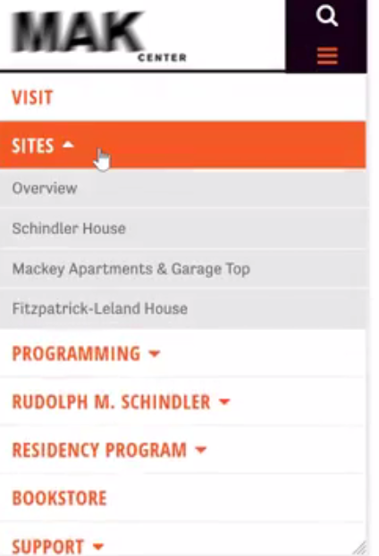
Hamburger Menu

Slide 42
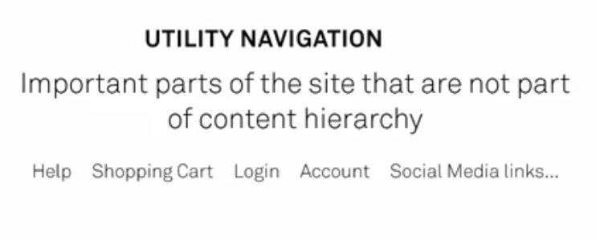

Slide 43
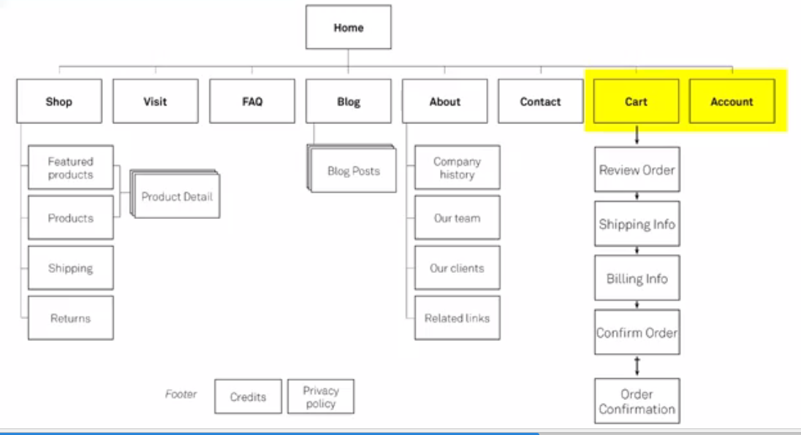

Slide 44
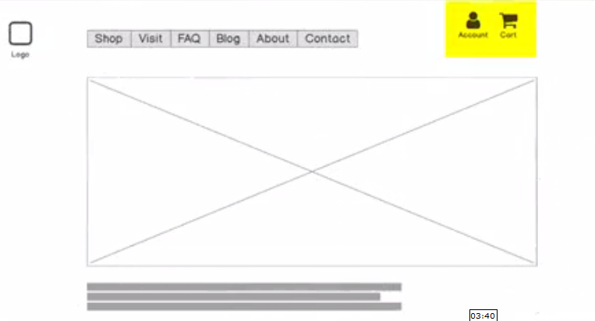

Slide 45
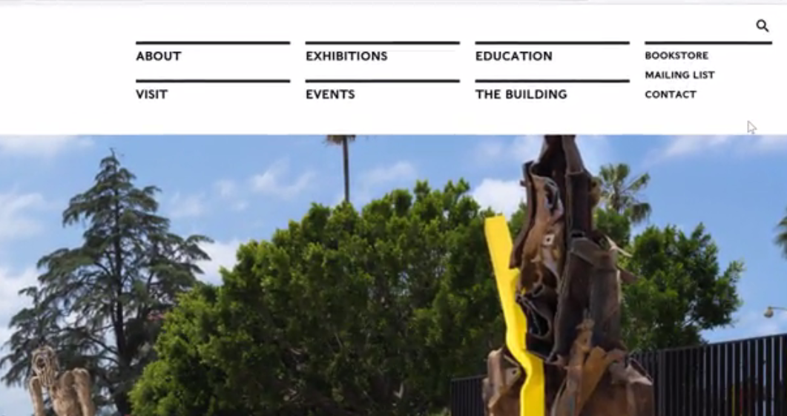

Slide 46
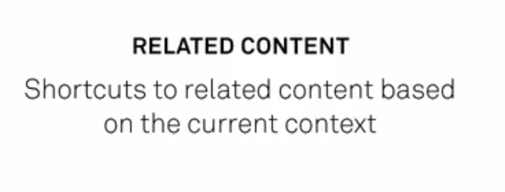

Slide 47
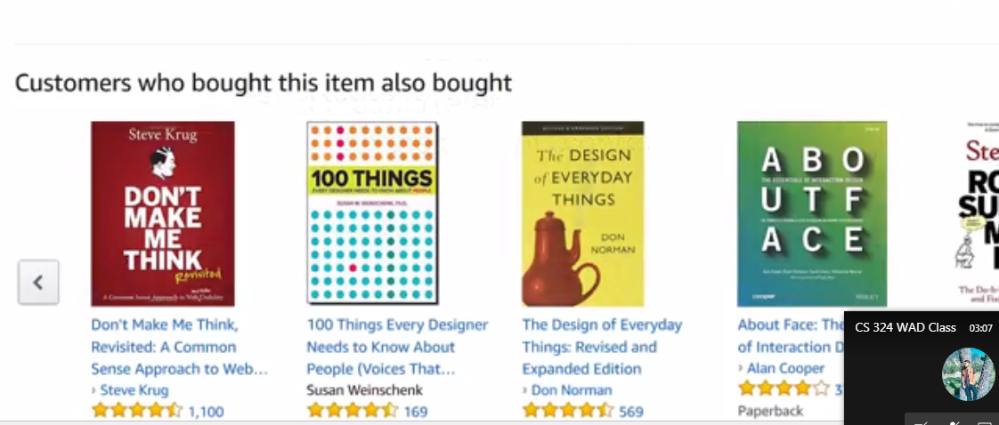
Example : Recommendations on ecommerce sites

Slide 48
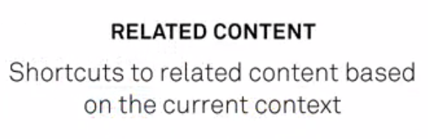

Slide 49
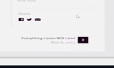

Slide 50
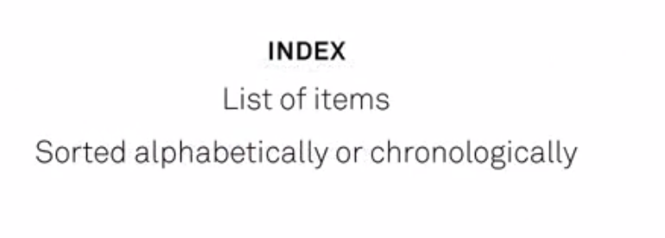

Slide 51
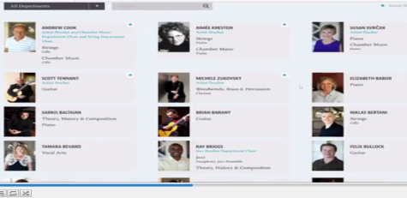
Pagination with filters for search

Slide 52
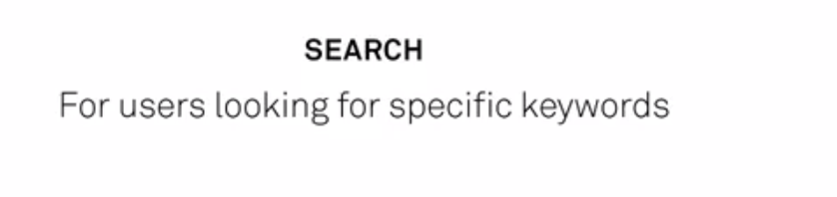

Slide 53
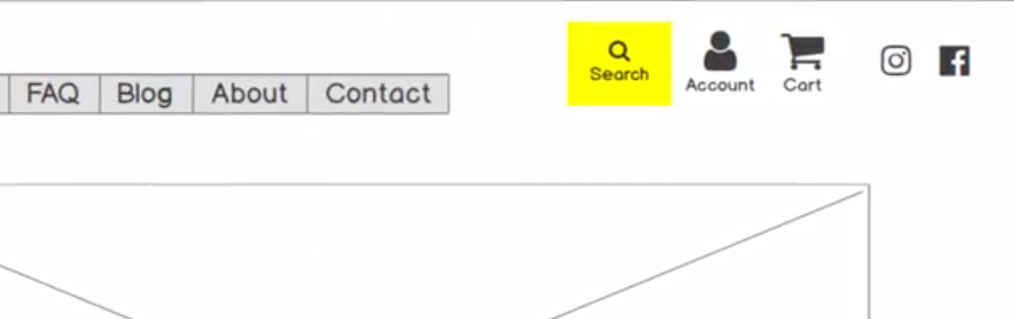

Slide 54

Where I am!

Slide 55

Like on maps
Clicked on a menu item; received an email and started going through emails.
Getting back to site, … where was I ….
Logo can be get back to home!
Consistent way to highlighting the page you are on in the menu!

Slide 57
Navigation
Primary Navigation
Secondary Navigation
Utility Navigation
Related Content
Inline Links
Index
Search

Slide 59
Where am I!
Logo can be get back to home!
Consistent way to highlighting the page you are on in the menu!
https://help.marvelapp.com/hc/en-us/articles/360002536038-A-guide-to-creating-your-first-prototype

